Slide 1
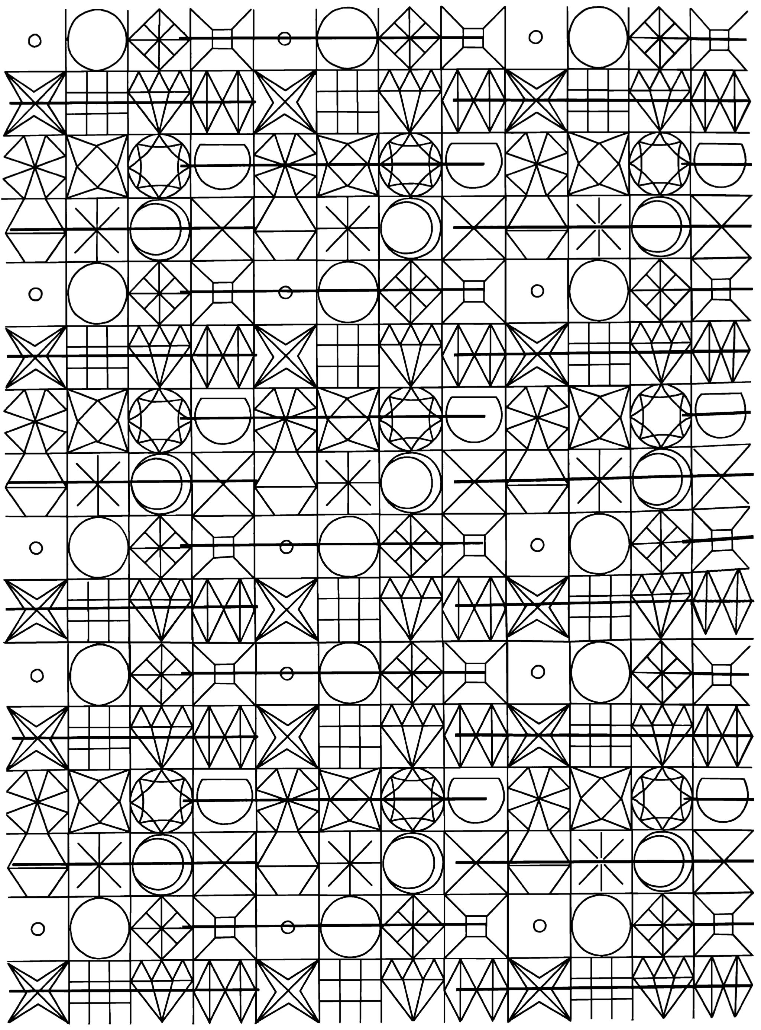
Effect Of Golden Ratio on aesthetic choice
Kyrylo Shyvam Kumar 2021101080
Vanshika Dhingra 2021101092

Slide 2
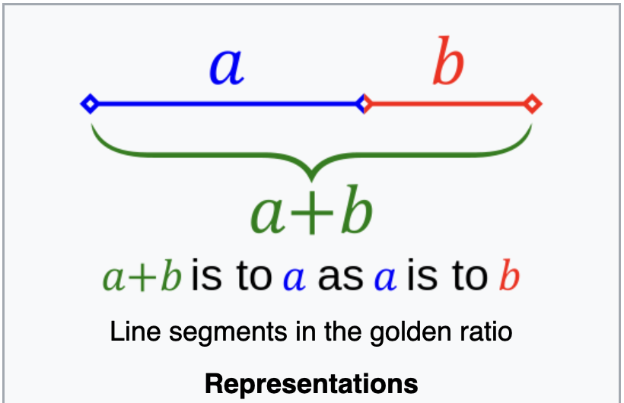
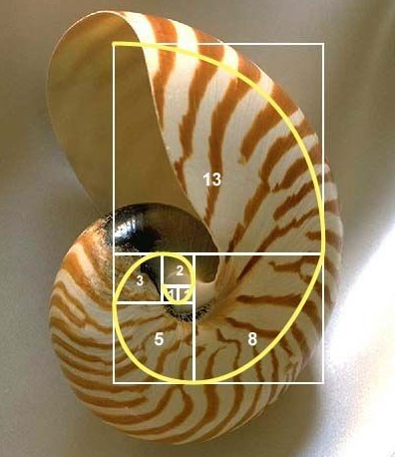
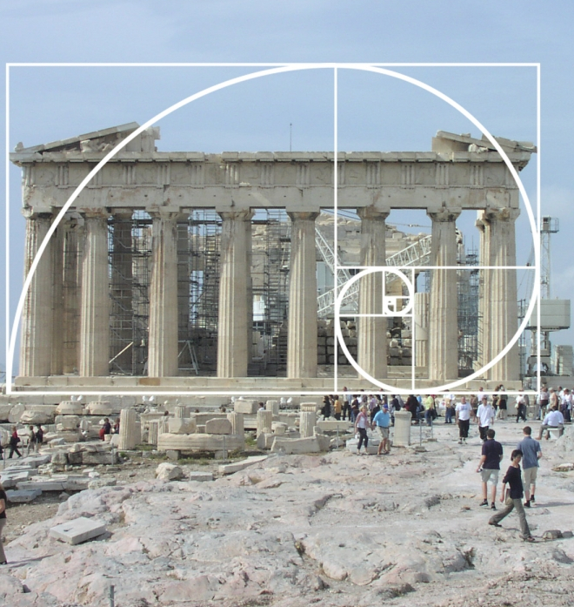
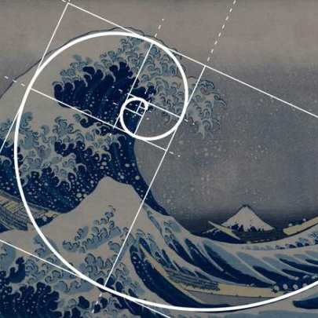
What is Golden Ratio?
In mathematics, two quantities are in the golden ratio if their ratio is the same as the ratio of their sum to the larger of the two quantities.

Slide 3
Introduction – Brief Introduction
The problem discussed here is the problem of proportion in aesthetics, which has been a topic of concern for over two and a half millennia. This problem essentially boils down to the question of how to arrange a small number of lines in the most harmonious manner.
The golden section, often defined by the ratio of 1.618:1 has been regarded as an aesthetic ideal in architecture and art. This ratio continues to influence design principles today, even though there is limited empirical evidence supporting its preference.
Hypothesis - this study hypothesizes that aesthetic preferences in visual design will primarily align with principles of symmetry, regularity, and simplicity, rather than conforming to specific numerical ratios, such as the golden section (1.618:1)

Slide 4
Previous Literature:
Green, (1995) conducted the extensive review of previous works. Some interesting ideas reviewed were if preference for ratio was influenced by culture. One comparative study, found difference in responses in Canadian and Japanese population. Japanese participants found shapes with unity ratio (square as compared to rectangle) more aesthetic.
More recent study try to approach the question from more practical perspective. Russell, (2000) experiments with different aspect ratios with a dataset of paintings and founds no correlation in golden aspect ratio and preference.
Raghubir, (2006) does similar with the shape of packages/cards. For different purposes, there were different peaks (at 1:1 or around 1.3:1) but there was nothing particular near golden ratio.

Slide 5
Research Methods
Sample Size: 30 to 40 people. We will perform 2 experiments using counterbalance technique so 4 orders in total 6-7 people for each order.
Google forms was used for 1st part, and image editing software Pinta for 2nd.
Study Design
Target Group : Educated Indian Population
Sample Group : University Students
Research Method: Survey research and experimental research
Research Strategy: Correlational Research
Research Design: Within Group
Consent form : It would be the part of the google form we share.

Slide 6
Research Methods
Variables
Gender(independent)
Artistic Training(independent)
Ratio of division of a figure (independent)
Personal aesthetic preferences(dependent)
Measures
Gender and artistic training are collected from responses of participants.
Ratio of division is provided either by participant (as a response) or experimenter depending on experiment performed.

Slide 7
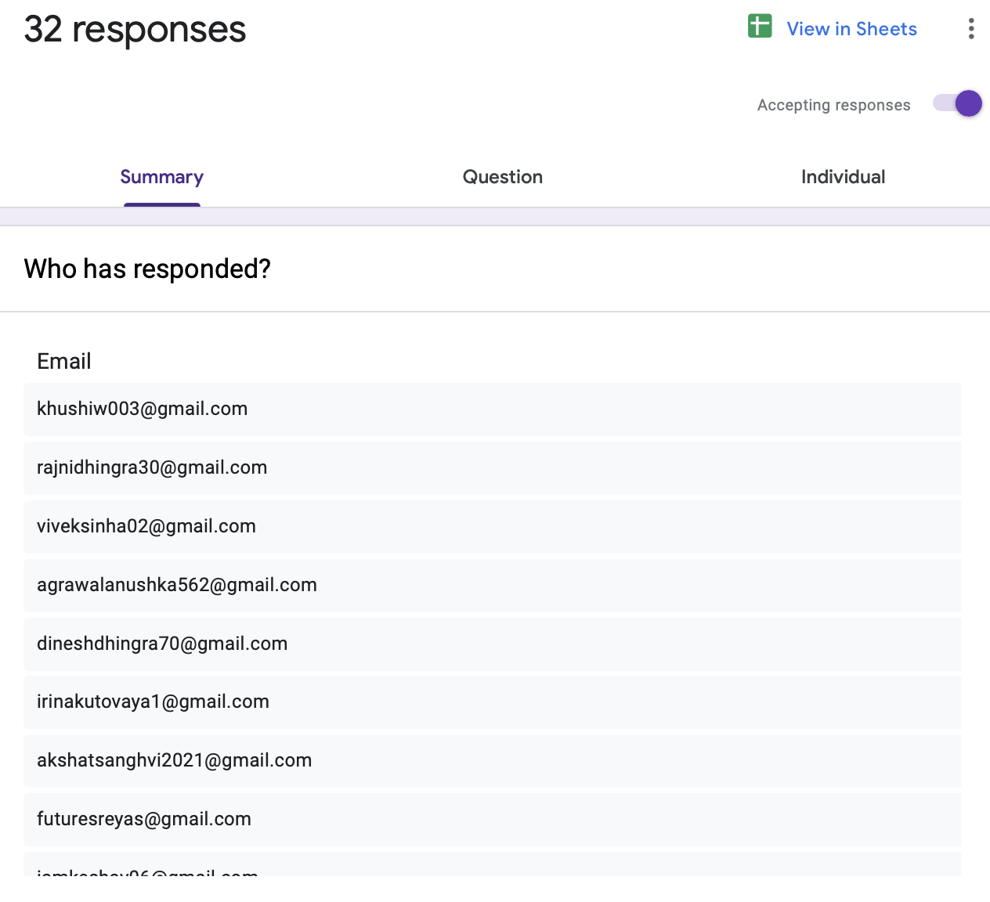
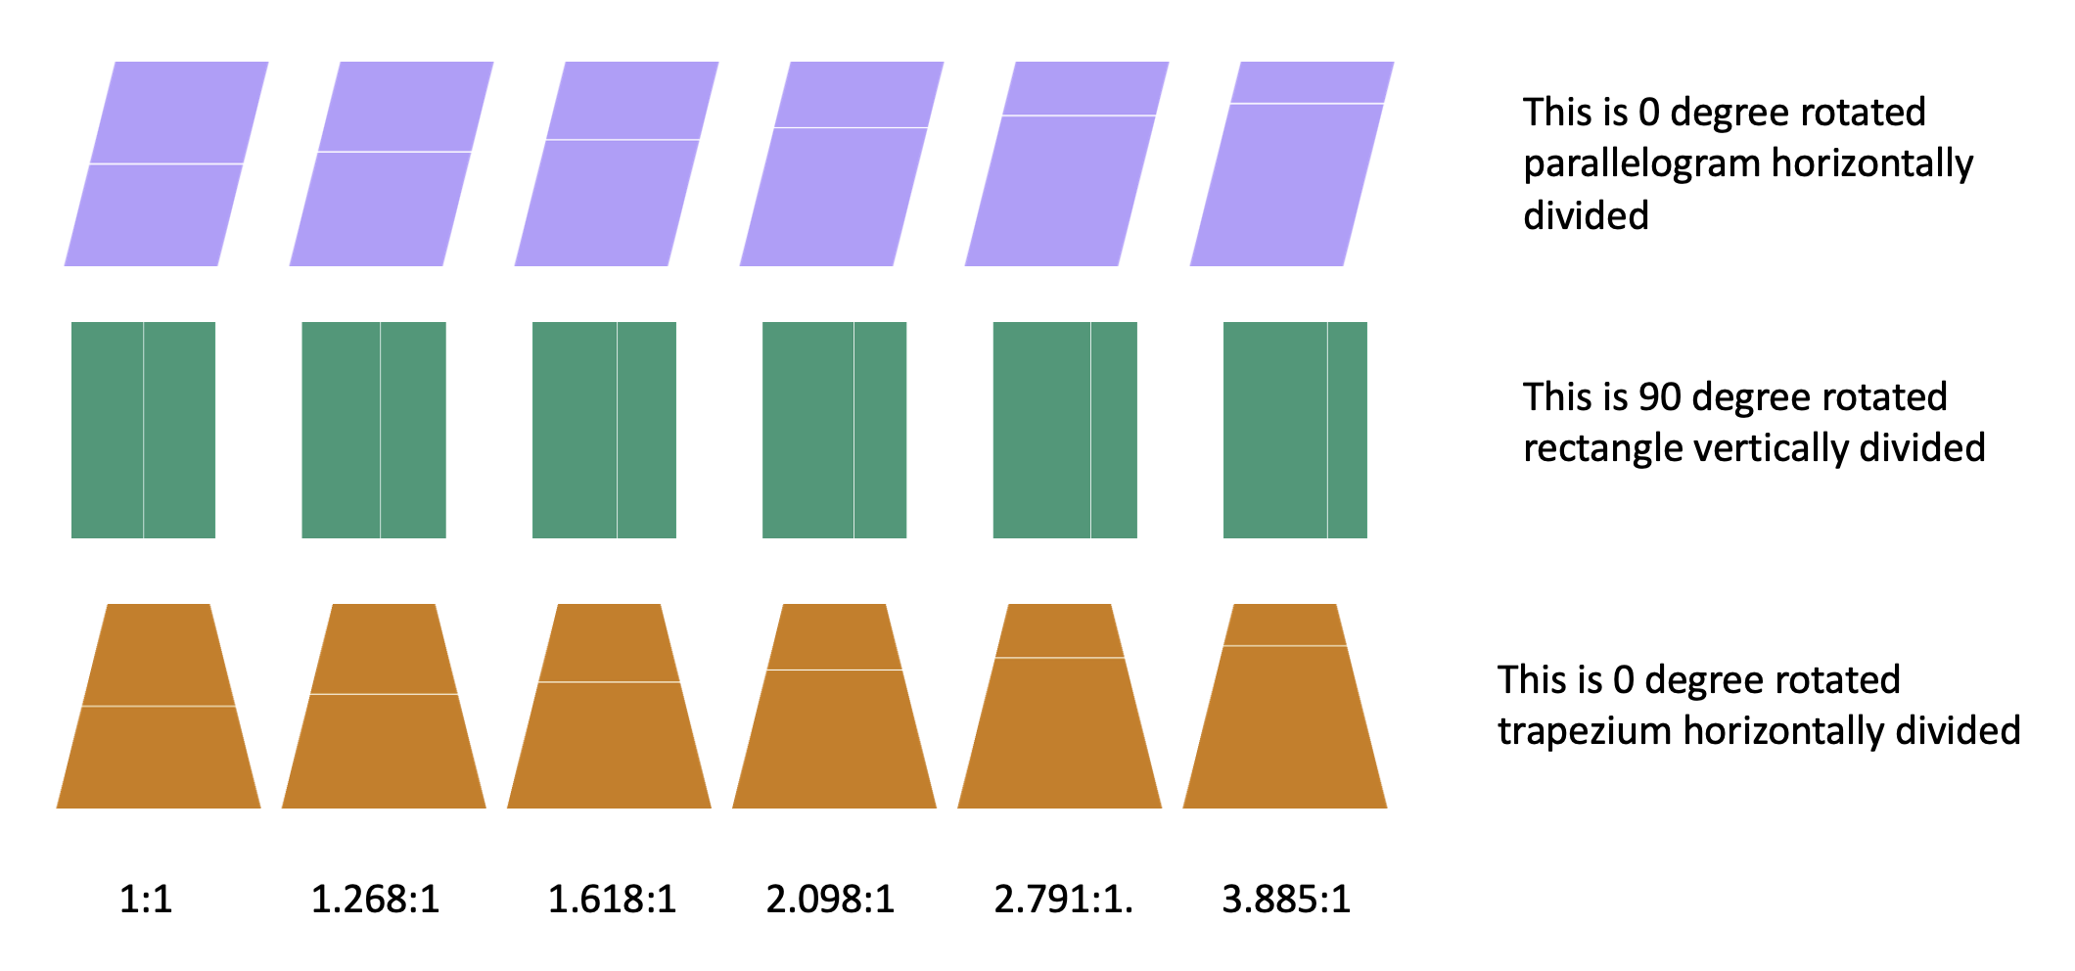
Experiment-1
Preparation Of Dataset- javascript application to generate the data
Procedure for making dataset- To nullify effect of orientation we present each shape, in 4 different orientations, rotated by 0,90,180,270 degrees. We also flip shapes, to make division into parts symmetric. For unsymmetric shapes like trapezium, we split both horizontally and vertically. Colour is assigned randomly across sets.
Google Forms- consent was taken, the questions are randomly arranged .

Slide 8
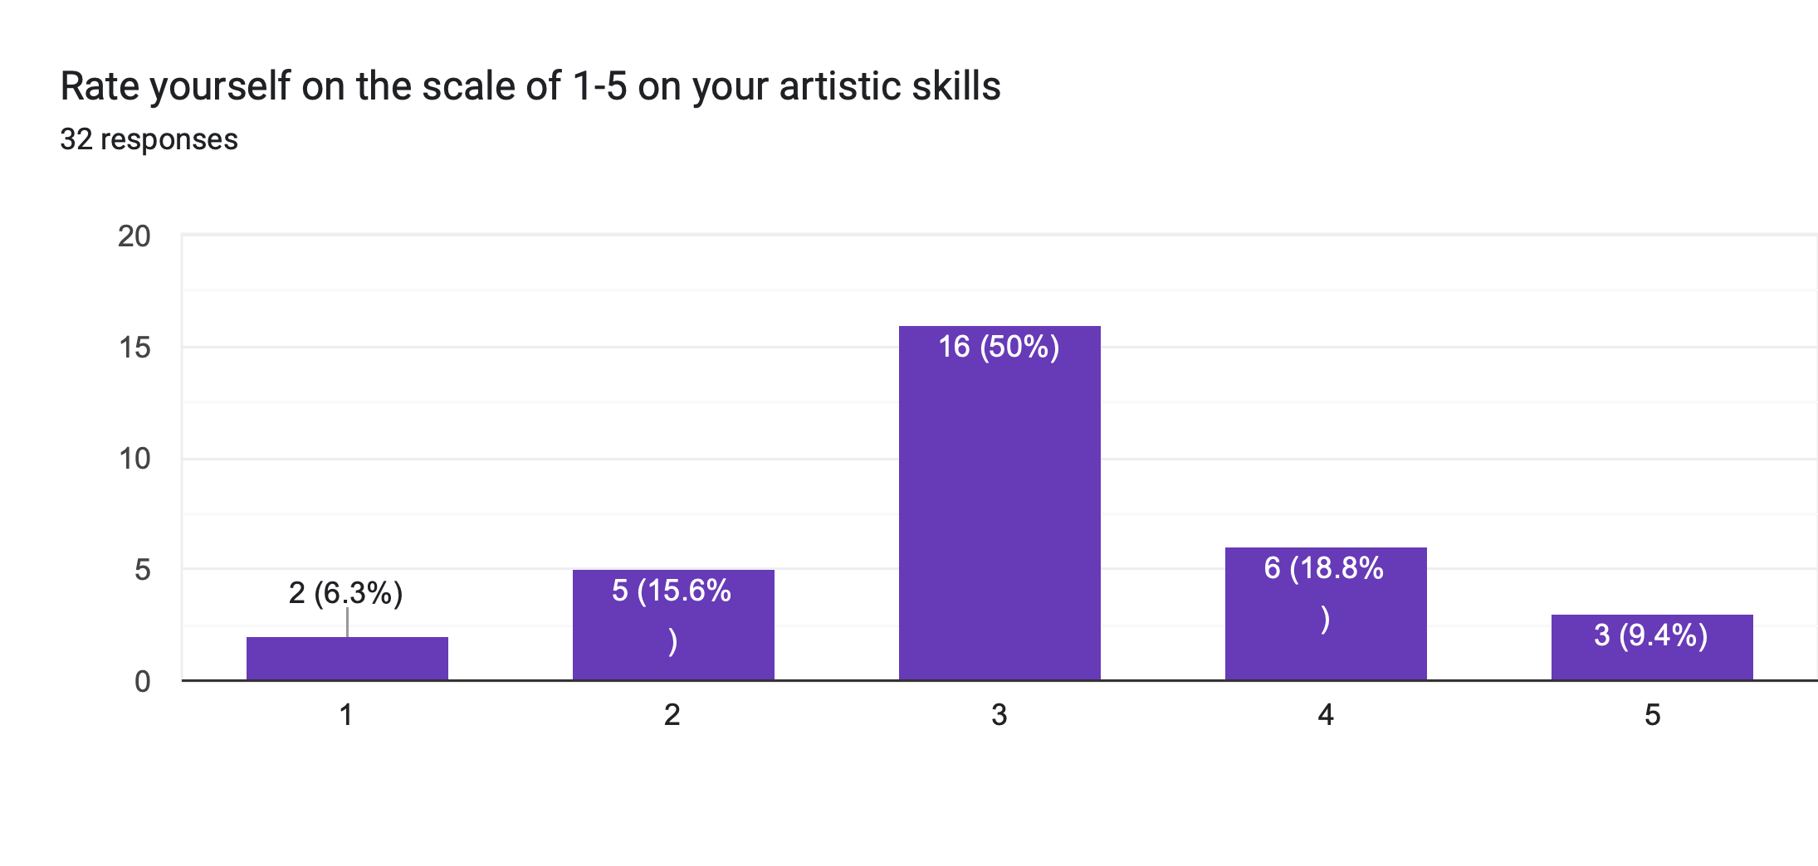
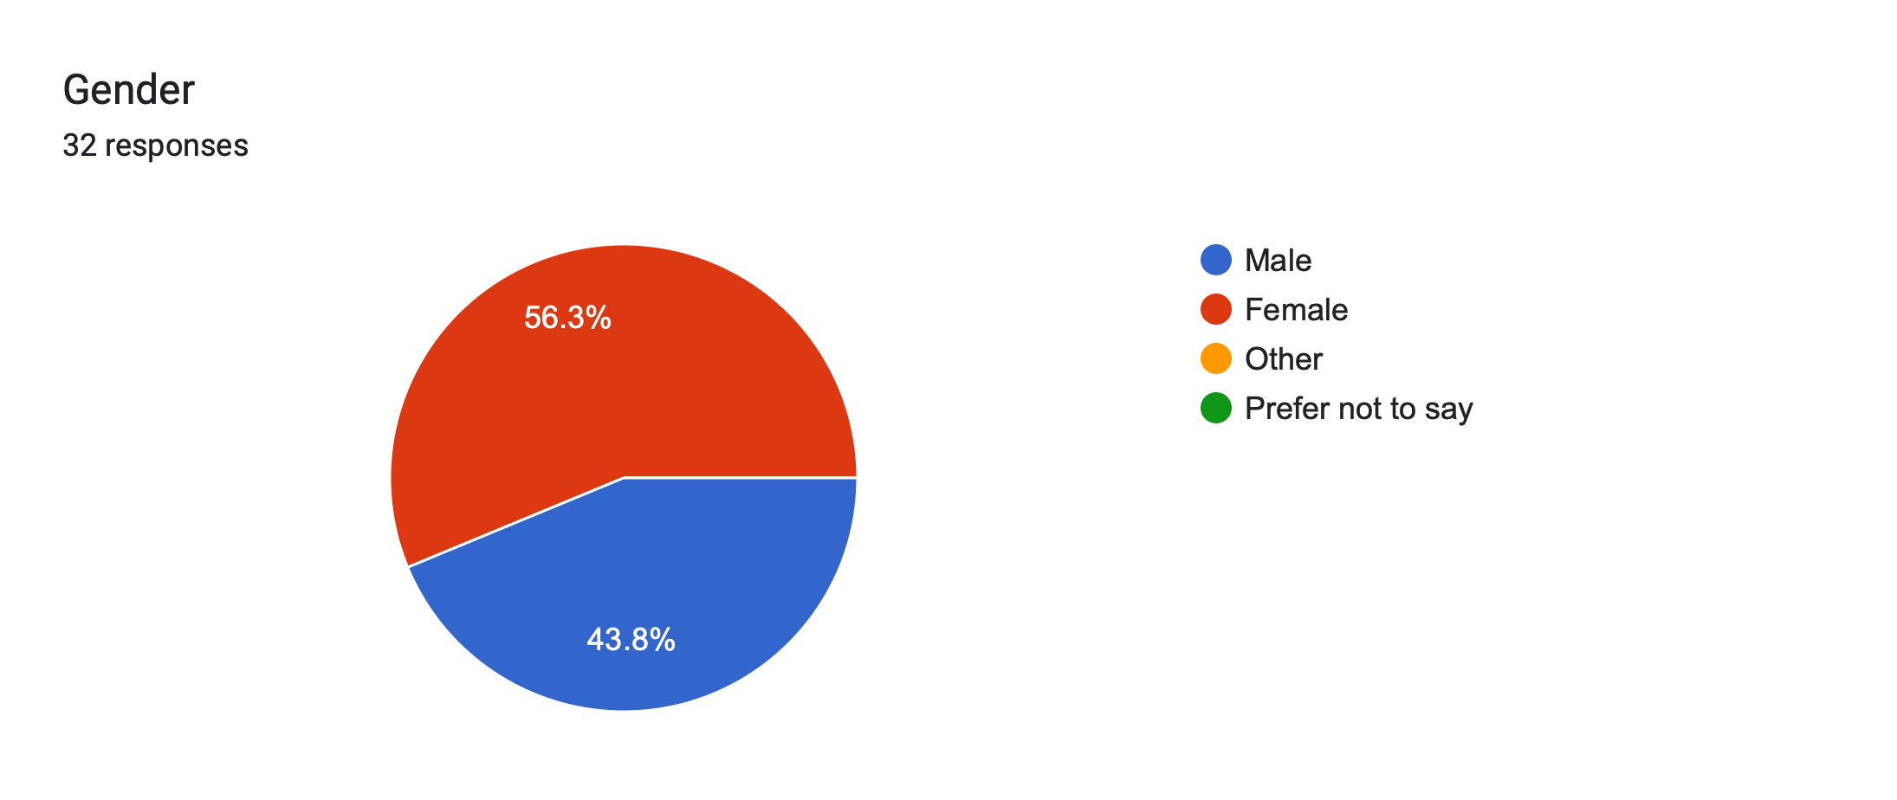
Experiment1-Results

Slide 9
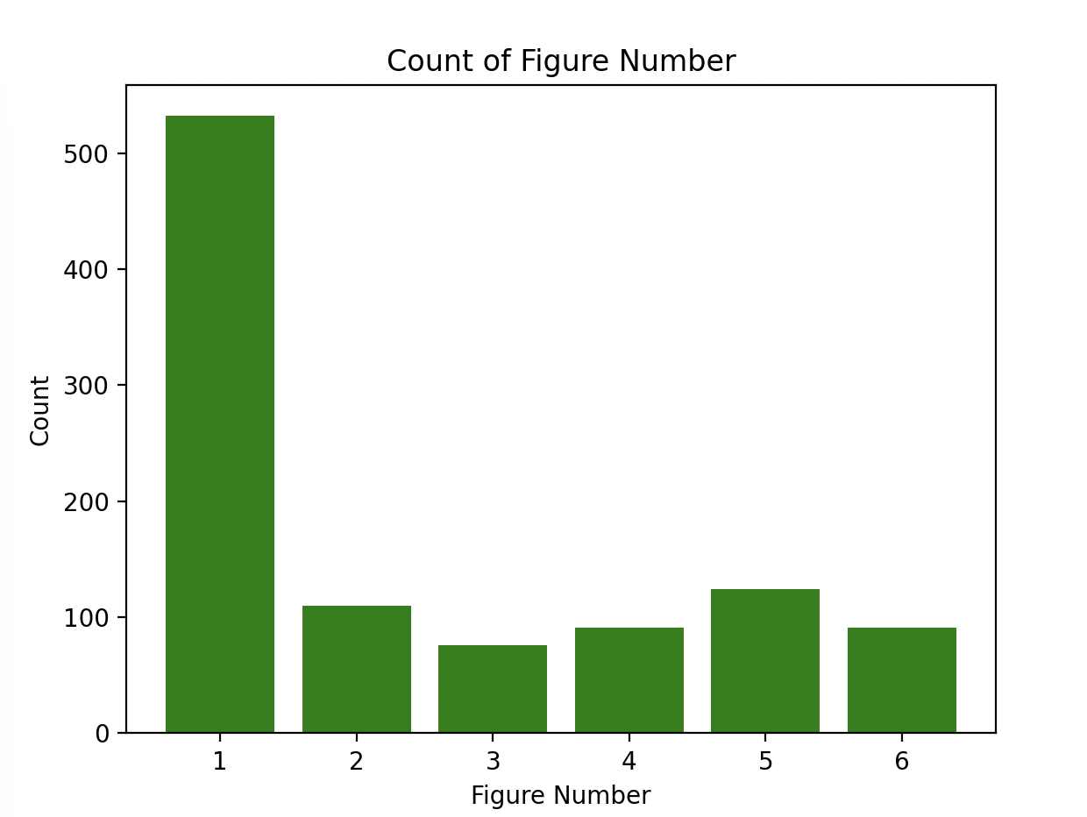
Results-Experiment1
What we can see from the graph is that most of the people chose the 1:1 ratio that matches with that of our hypotheses.
There is also another peak at the ratio 2.791:1.

Slide 10
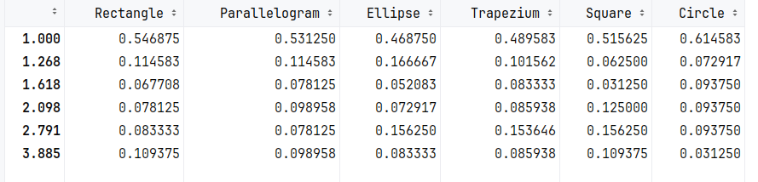
Results-Experiment1
Proportion of occurance of each ratio

Slide 11
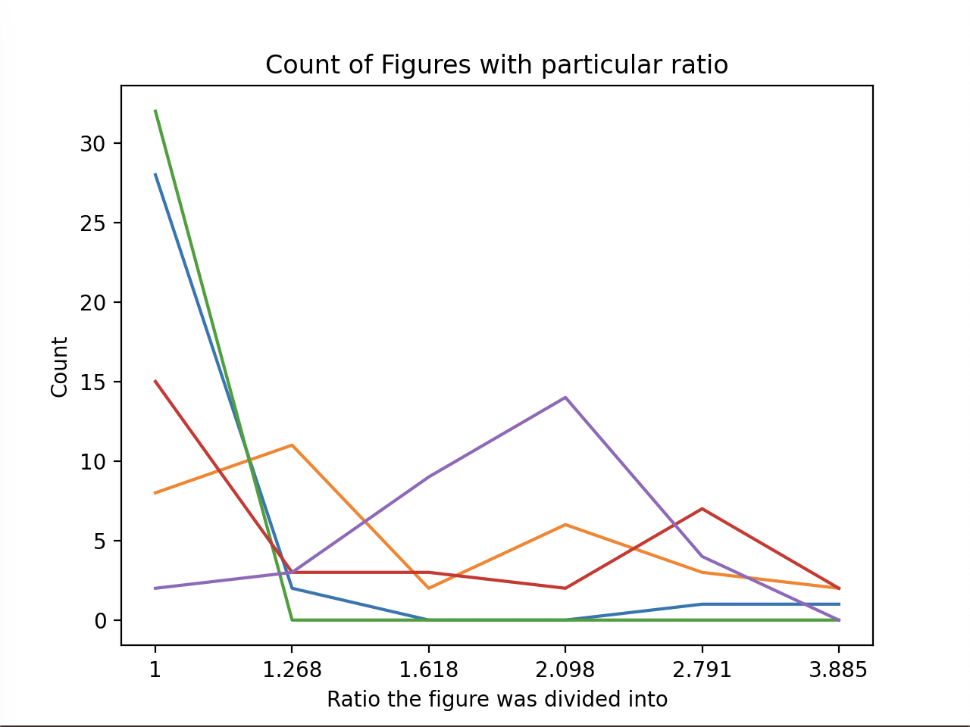
Results-Experiment1
Different lines represent different participants.
We see that for each participant there is one major peak. This is consistent with explanation that preference varies among people but is almost constant for a single person.
Also we can see that for most of the people the peak comes at 1:1 ratio.
Almost no one selected golden ratio

Slide 12
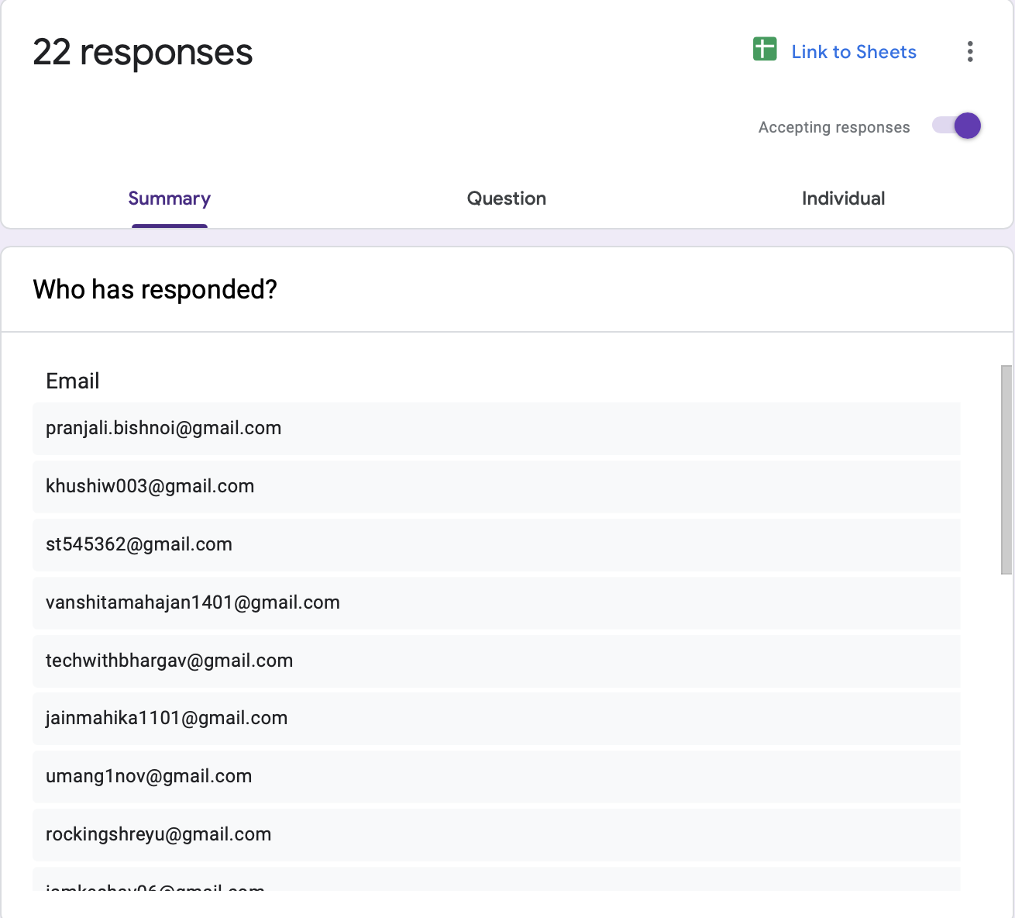
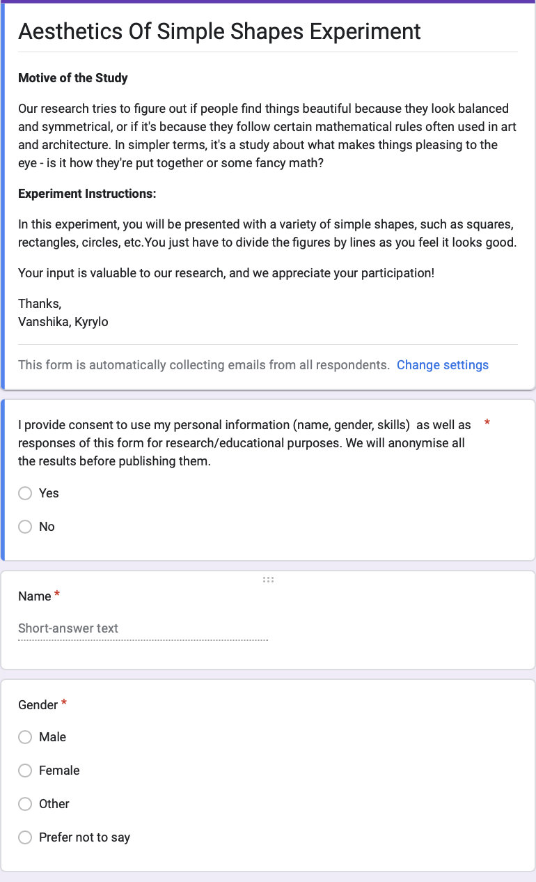
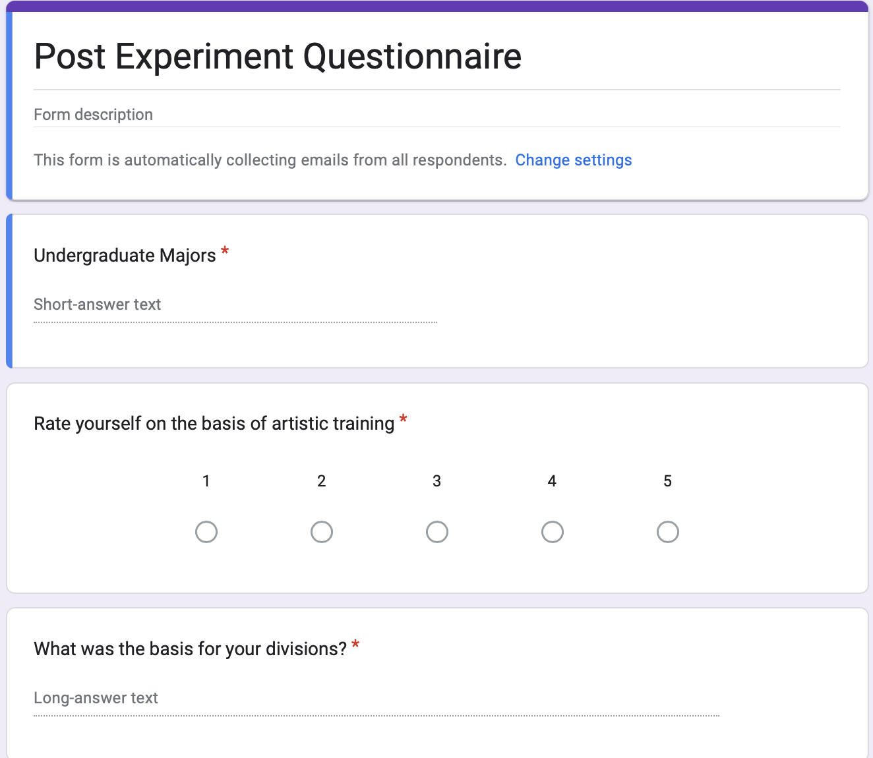
Experiment 2 - Production Method

Slide 13
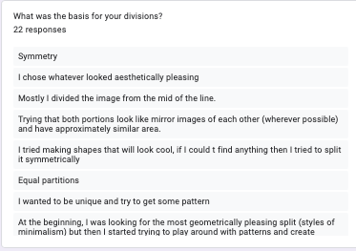
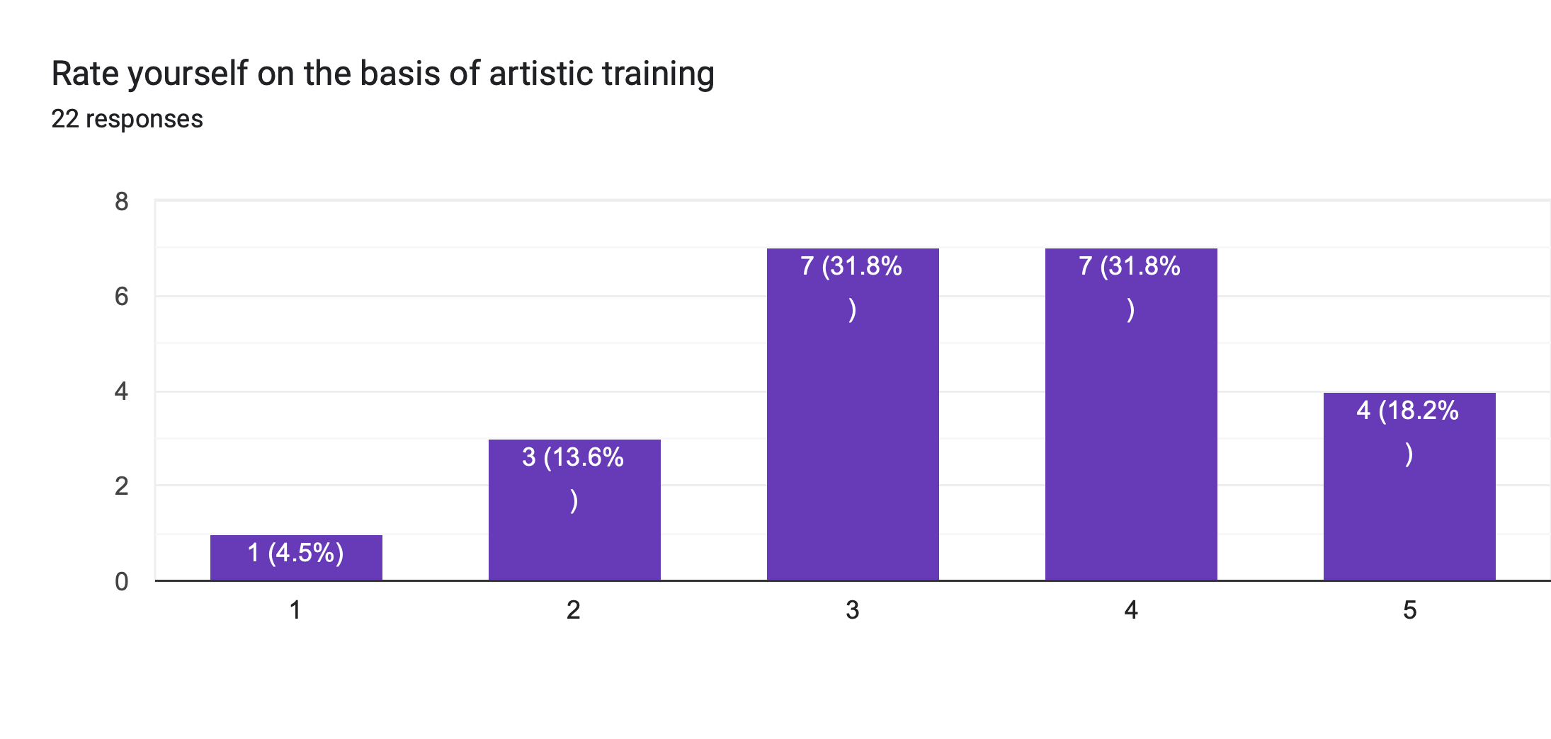
Experiment 2 - Production Method

Slide 14
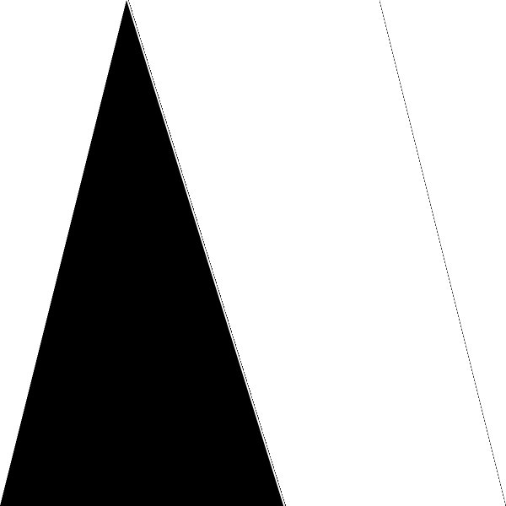
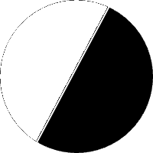
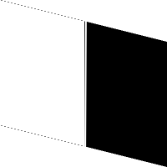

Experiment 2 - Production Method
Some sample divisions done by participants

Slide 15
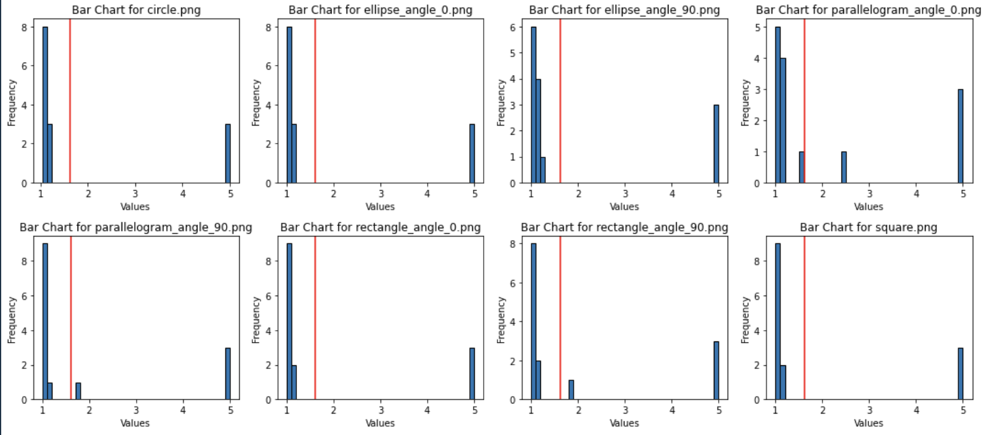
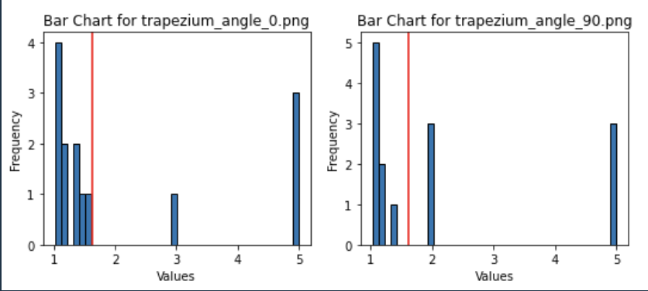
Results-Experiment-2-Small Images
Most of the people divided the figures into near symmetry ratios although there were some of outliers.

Slide 16
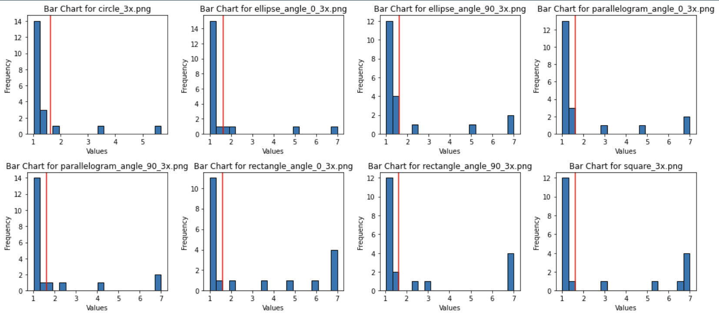
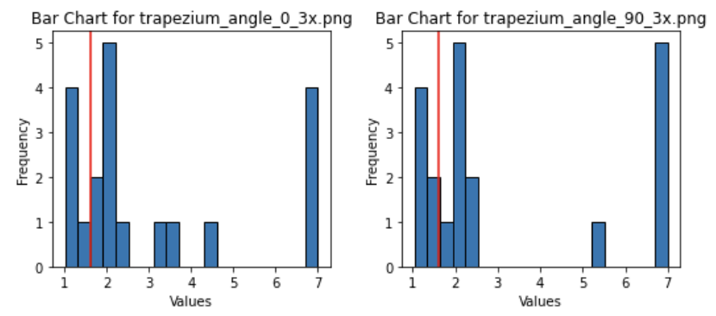
Results-Experiment-2-big Images
Most of the people divided the figures into near symmetry ratios although there were some of outliers.

Slide 17
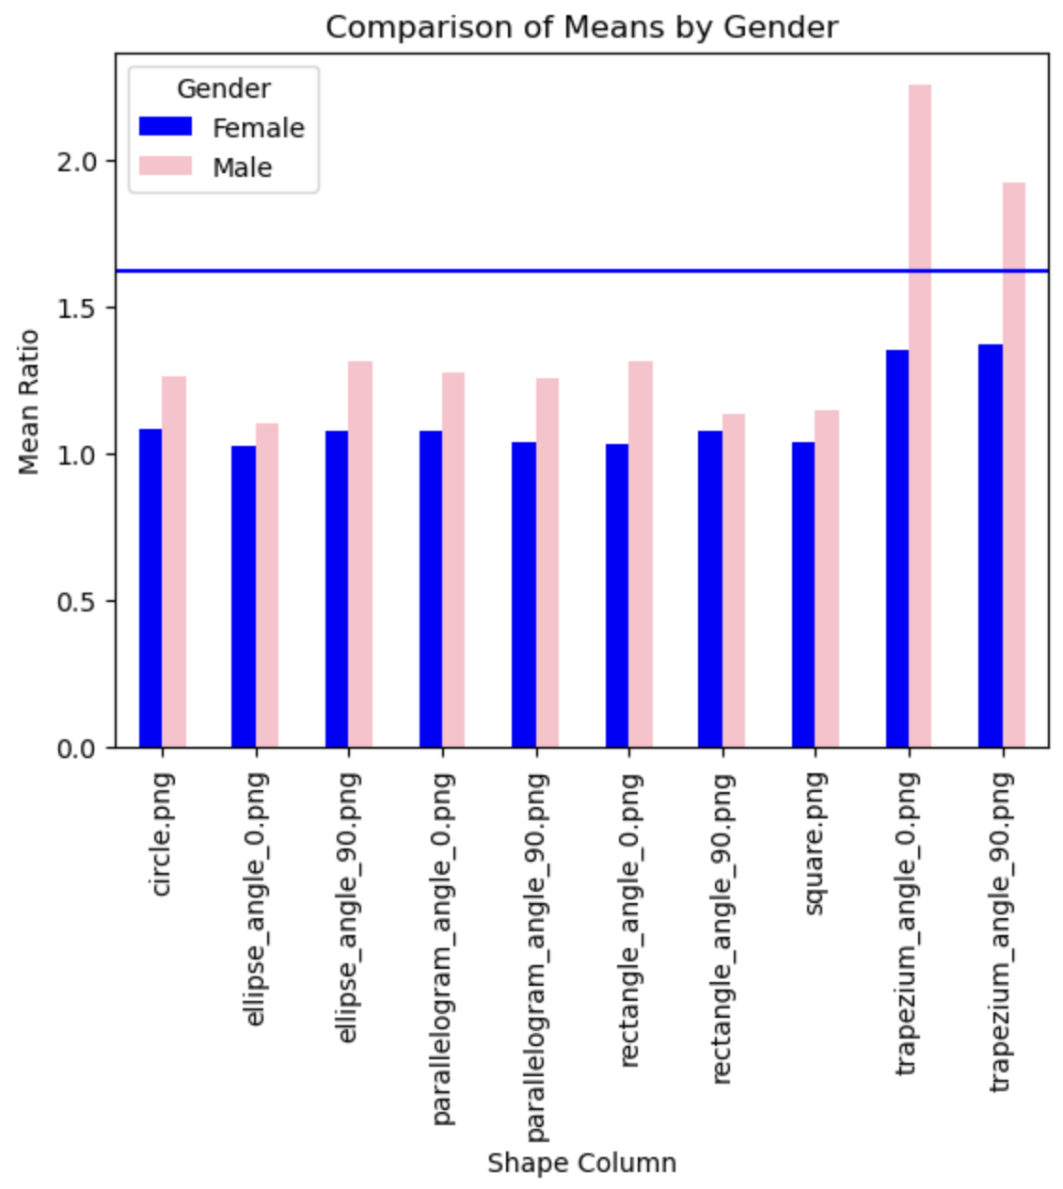
Results-Experiment2
We found that male tend to divide the shapes in such a way that the ratio is greater than females but is still less than golden ration and significantly close to symmetry.

Slide 18
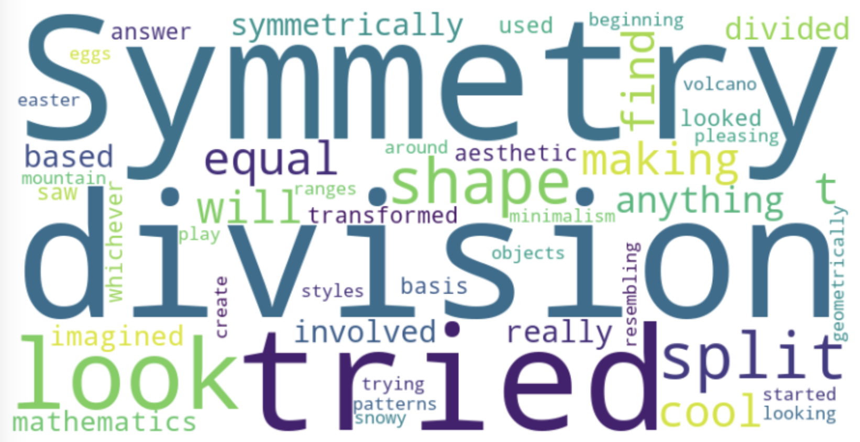
Results-Experiment2
We asked people what were the basis of their divisions. We have made a word cloud out of their responses and we can clearly see since symmetry is shown bigger that means many of the people included the ans for their basis of divsions as symmetry.

Slide 19
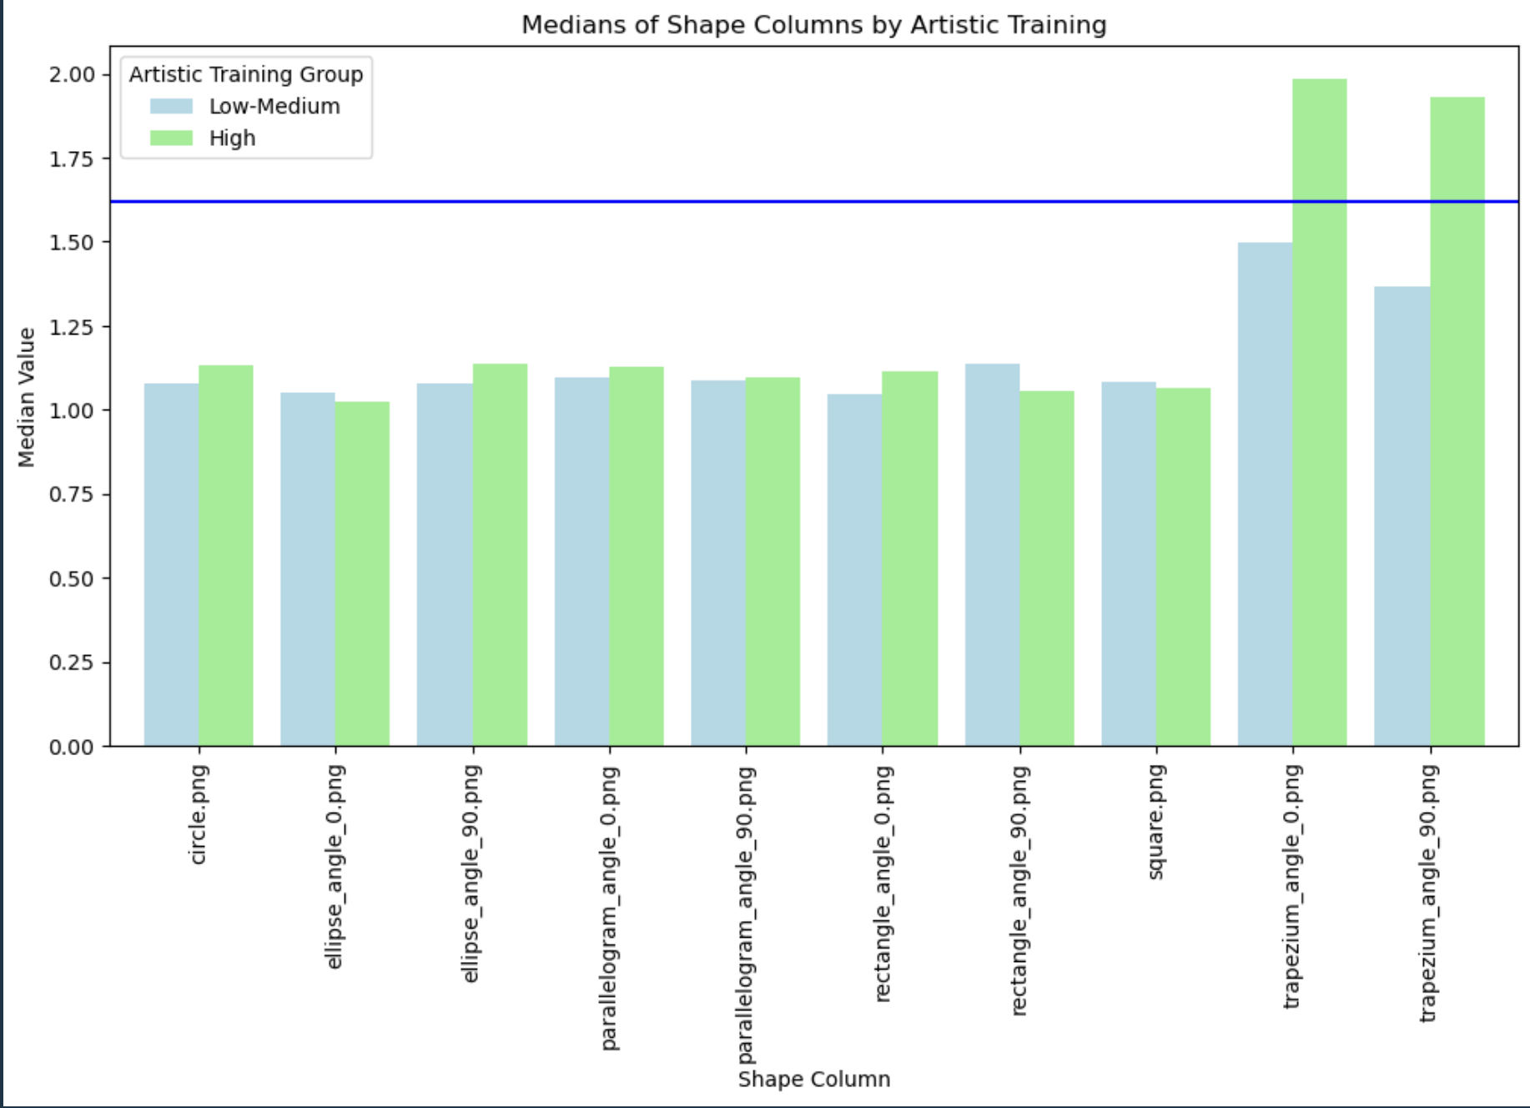
Results-Experiment2
We can see that for most of the shapes the people with high artistic training have somewhat more median value which is also near to symmetry and not to golden ratio

Slide 20

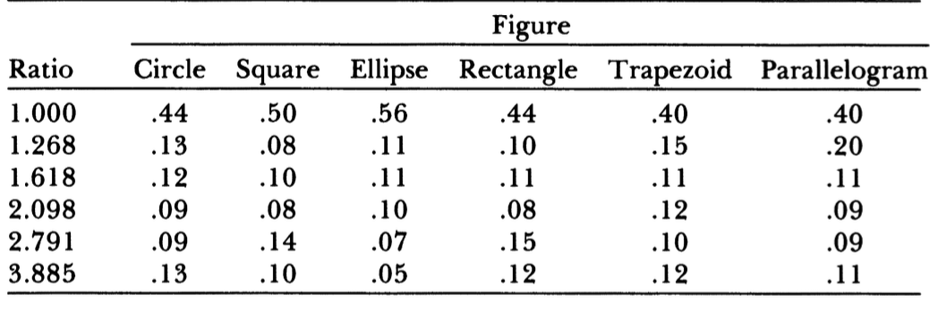
Results Compared With Previous Study Experiment1

Slide 21
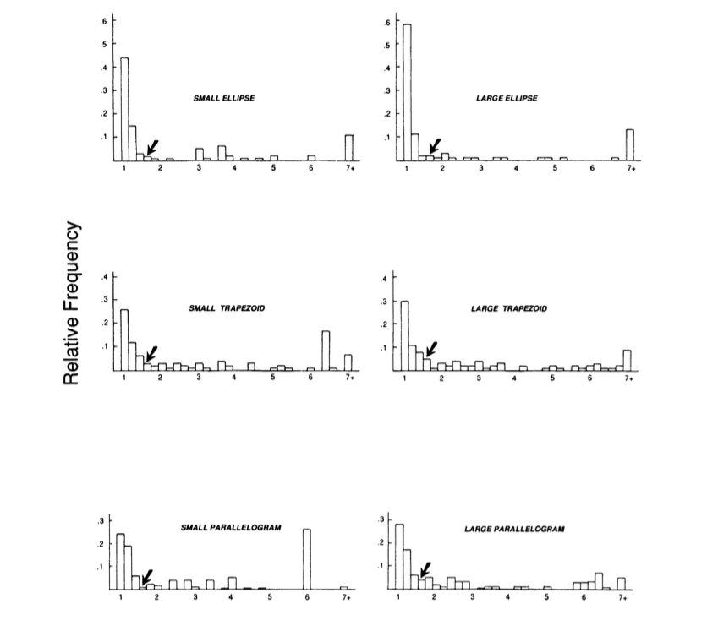
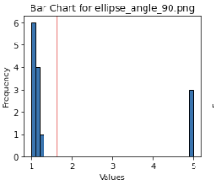
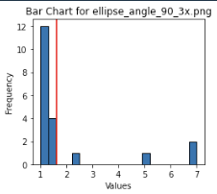
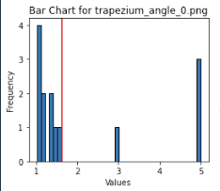
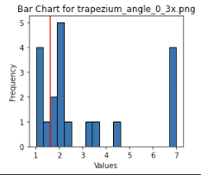
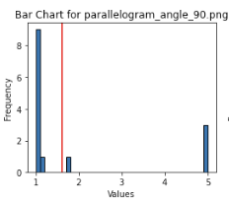
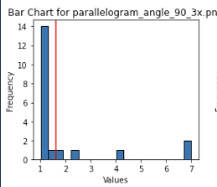
Results Compared With Previous Study Experiment2

Slide 22
Results Compared with other Studies/ Previous Study
A major portion of divisions were centered around 1. There were some divisions with extreme ratio, as in previous work by Davis et. Al (1991).
There is no actual difference between small and large shapes.
Ratio of division strongly depends on shape of polygon.
The only reason for larger mean ratio is that some male participants choose more extreme ratios, increasing the average.
People who rate themselves with higher artistic training draw shapes with a little higher ratio, which is still less than golden.

Slide 23
Individual Team Member Contribution
Equal contribution by both members.

Slide 24
Thank You !!

